Slide 1
Group 19 LFMT
Automated Planter
Mason Trippel & Lucas Fox

Slide 2
Mason Trippel
Bio/Responsibilities
Major: Computer Engineering
Skills: Microcontroller Programming/Wiring, 3D Design, Circuit & PCB Design
Responsibilities: Budgeting, Hardware & Microcontroller Programming,

Slide 3
Lucas Fox
Bio/Responsibilities
Major: Computer Science
Skills: Software Engineering, Mobile App Development, Web Development, Full-stack
Responsibilities: Handle app development and UX

Slide 4
The problem
Stages of plant ownership
01
You spend $20-40 on a house plant. It looks nice and you try to take care of think it will never die under your watch.
02
You forgot to water it for the last two weeks, but it’s still green…ish. You give it some water and expect it to come back to full health.
03
The plant is now beyond saving and in an effort to shield yourself from the responsibility you throw it outside to rot away.

Slide 5
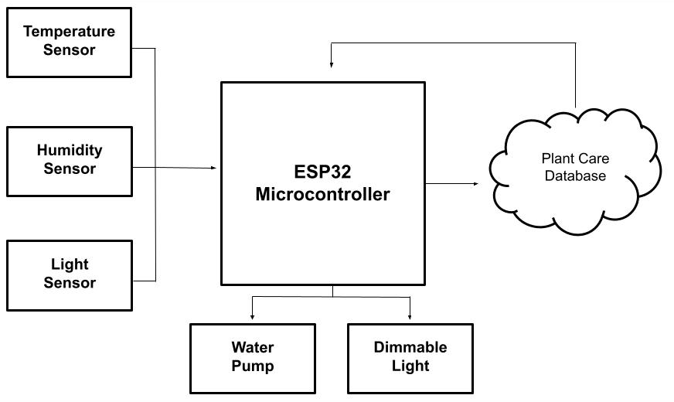
Project objective
Design a device that can:
Ensure plant health by varying the amount of light & water your your plant receives
Measure important environmental factors
Use measurements to optimize the environment for the plants health
Report this data to the user
Notify the user of any issues and when maintenance is required

Slide 6
Proposed Solution
IOT Device
Dynamic Application
Simple UI/UX
3D-Printable
Open Source

Slide 7
Budget
Item | Cost
ESP32 Microcontroller | $7.00
Water Pump | $6.00
Misc Sensors/ICs | $6.50
Misc Hardware | $25.00
Test Environment/Enclosure | $20.00
Total | $64.50

Slide 8
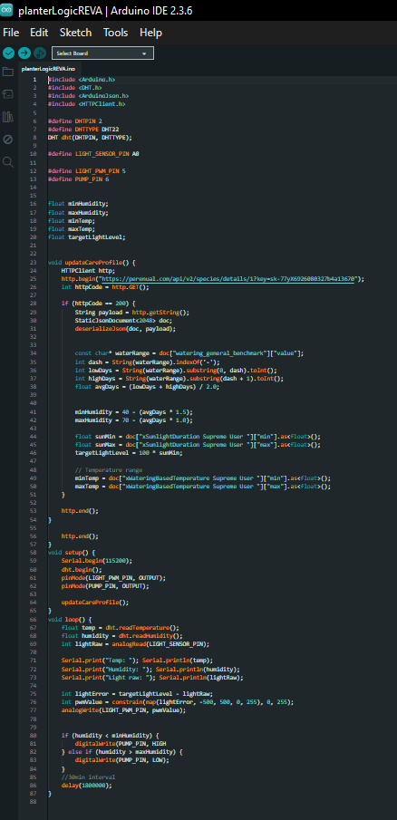

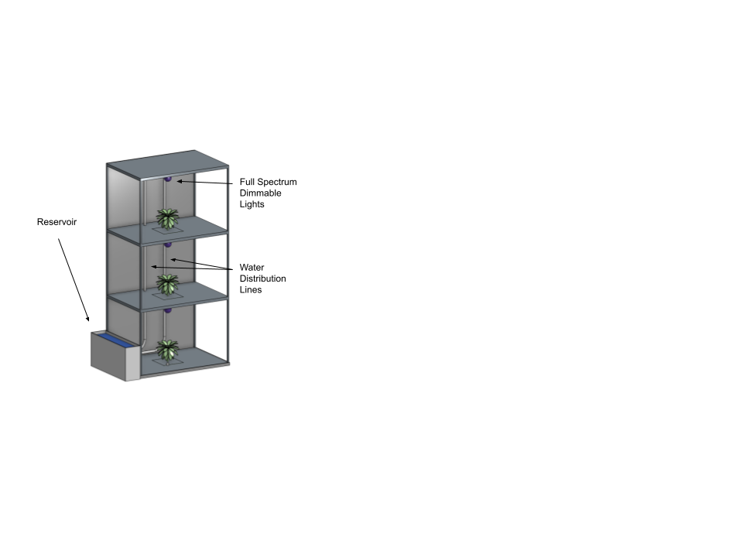
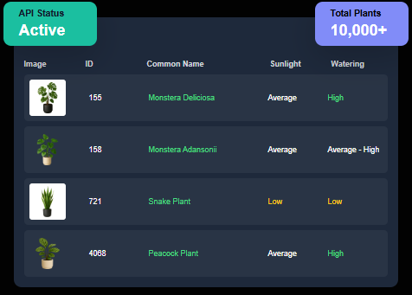
Progress to Date
Microcontroller Program Outline
Plant Care API (Perenual)
3D Model

Slide 9
